Slide 1
Standards-Based Data Exchange
Address product identification, data definitions, business document lay out, or business process sequences
RosettaNet (electronics)
Chemical Industry Data Exchange
ACORD (insurance)
Petroleum Industry Data Exchange
Automotive Industry Action Group
Aerospace Industries Association
MERS (mortgage industry)

Slide 2
Extensible Markup Language (XML)
A markup language that defines a set of rules for encoding documents in a format which is both human-readable and machine-readable. It is defined by the W3C's XML 1.0 Specification and by several other related specifications, all of which are free open standards
XML is more human-readable than EDI

Slide 3
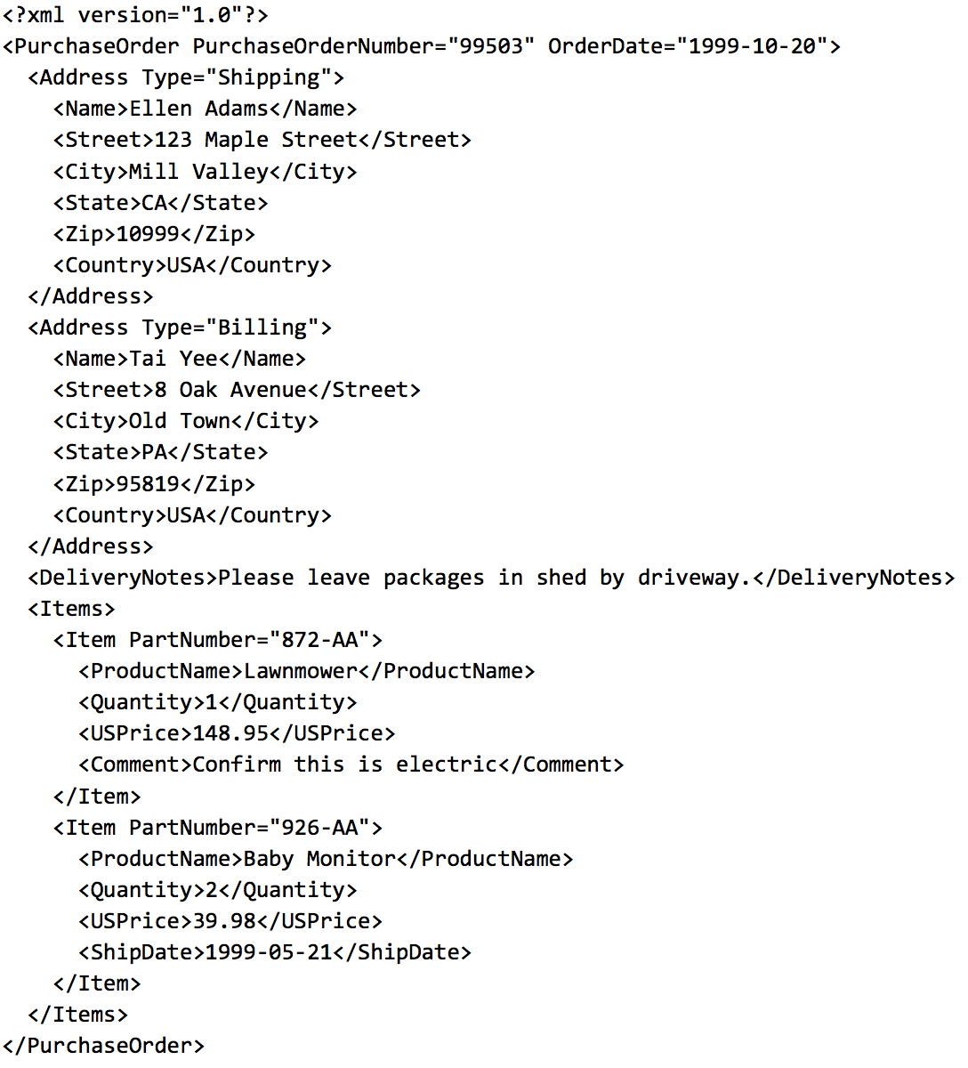

Slide 4

RFID doesn’t need to be passed under a reader like bar codes
RFID tags can be read much more quickly than bar codes
RFID can hold much more information than bar codes.
Some additional data RFID can store:
Country of origin
Expiration date
Real-time tracking

Slide 5
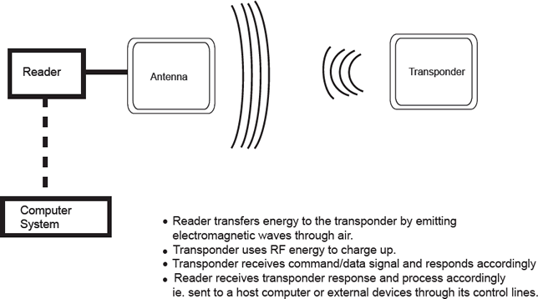
Source: http://people.sunyit.edu/~deciccm/RFID%20Stuff/RFID%20Scrapbook/data/20061027154911/

Slide 6
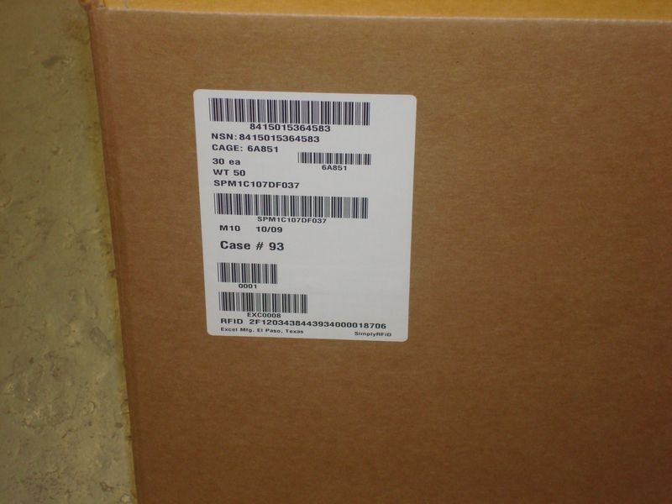
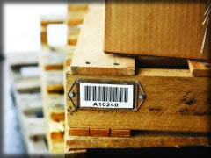
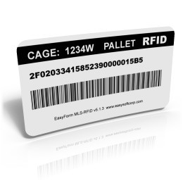
RFID Examples

Slide 7
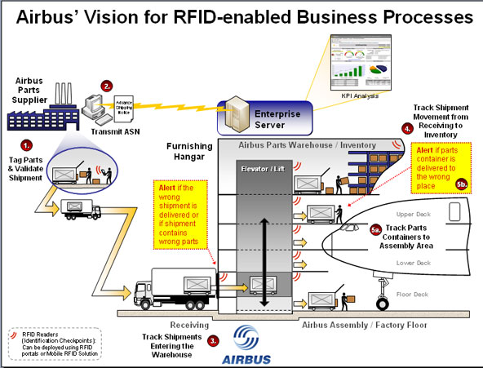

Slide 8
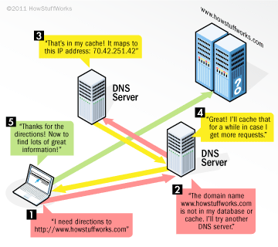
Domain Name System (DNS) Lookup

Slide 9
The Internet Corporation for Assigned Names and Numbers (ICANN)
Internationally organized, non-profit corporation that has responsibility for Internet Protocol (IP) address space allocation, protocol identifier assignment, generic (gTLD) and country code (ccTLD) Top-Level Domain name system management, and root server system management functions.
These services were originally performed under U.S. Government contract by the Internet Assigned Numbers Authority (IANA) and other entities. ICANN now performs the IANA function.

Slide 10
ICANN and USC
Before the establishment of ICANN, the IANA function of administering registries of Internet protocol identifiers (including the distributing top-level domains and IP addresses) was performed by Jon Postel, a Computer Science researcher who had been involved in the creation of ARPANET, first at UCLA and then at USC-ISI
In 1997 Postel testified before Congress that this had come about as a "side task" to this research work. The Information Sciences Institute was funded by the U.S. Department of Defense, as was SRI International's Network Information Center, which also performed some assigned name functions.^{[13]}
Source: Wikipedia

Slide 11
SQL Index
An index is used to speed up the performance of queries. It does this by reducing the number of database data pages that have to be visited/scanned.
Clustered and unclustered
Clustered index determines the physical order of data in a table.
There can be only one clustered index per table
Nonclustered index contains the nonclustered index key values and each key value entry has a pointer to the data row that contains the key value.
Multiple clustered indexes possible.
“An index to the main index”
Source: https://technet.microsoft.com/en-us/library/ms190457(v=sql.110).aspx

Slide 12
Subqueries
Inner SELECT statement used in outer statement to help determine the contents of the final result
Subqueries may also also appear in INSERT, UPDATE, and DeLETE statement
SELECT staffNo, fName, lName, position
FROM staff
WHERE branchNo = (SELECT branchNo
FROM Branch
WHERE street = ‘163 Main St’);

Slide 13
SQL Joins
Used to create a single result set from multiple tables
Uses foreign keys to connect data from one table with data from another table
Typically uses logical operators such as EQUAL = or NOT EQUAL <> but can use other operators
Default: “JOIN” = inner join
Left/right joins refer to first table and second table
SQL: SELECT branch.branchNo, order.delivery_address FROM order JOIN concrete_type.concrete_type concrete_type ON order.concrete_type = concrete_type.concrete_type;

Slide 14
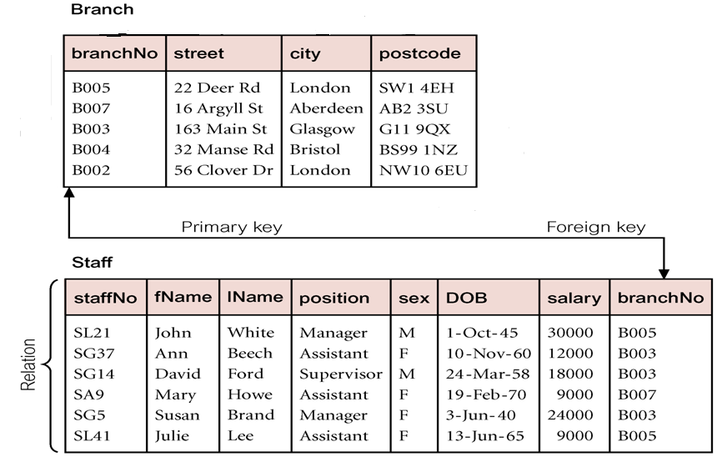
How to combine info across tables using SQL?

Slide 15
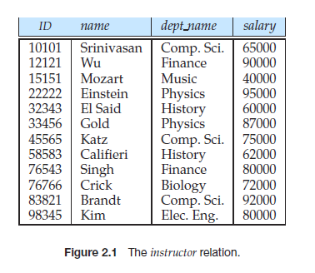
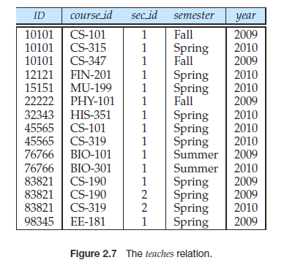
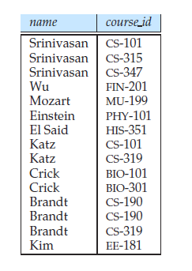
<-PK?
FK->?
Form row pairs using home table (instructor) & foreign table (teaches) with matching columns
(FK-PK)
List name of instructor & course_id for courses he/she teaching
SELECT name, course_id
FROM instructor, teaches
WHERE instructor.ID=teaches.ID

Slide 16
Table Alias
When joining two tables you must specify the variable name’s table
Example: the branchNo variable from the Branch table would be defined as “Branch.branchNo”
You can save yourself some typing by using an alias
SELECT column_name(s) FROM table_name AS alias_name;
Example: Substitute “b” for Branch table and “s” for Staff table

Slide 17
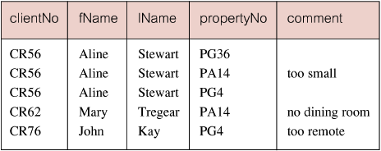
Example 6.24: Simple Join
List names of all clients who have viewed a property & their comments (use client and viewing table)
SELECT c.clientNo, c.fName, c.lName, v.propertyNo, v.comment
FROM Client c, Viewing v
WHERE c.clientNo = v.clientNo;
In results, only rows from both tables that have identical values in the clientNo columns.
Equivalent to equi-join in relational algebra.
FK in foreign tables (v) matches PK in home table (c)
That’s why we need to study FK-PK!
17

Slide 18
Join multiple tables
Negative example 1 – Data Breach
e.g. 3 types of Identity Info are leaked in a “identify table”
1. SSN --Security Identity (Government/CreditCard/Insurance)
2. UID – school identity (dorm,gym,dining,campus health,gpa)
3. Name – real world identity (family/social/)
So anyone with a part of info previously now can know your activity in other parts by simply joining their own table with this “identity table”

Slide 19
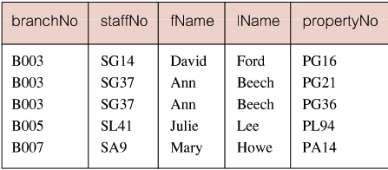
Example 6.25: Simple Join & Sorting
For each branch office, list staffNo and names of staff who manage properties, and the property number and type that they manage. (use Staff and PropertyForRent table)
SELECT s.branchNo, s.staffNo, s.fName, s.lName, p.propertyNo, p.type
FROM Staff s, PropertyForRent p
WHERE s.staffNo = p.staffNo
ORDER BY s.branchNo, s.staffNo, p.propertyNo;
19

Slide 20
Multi-Table Join with Selection Predicates
List the fname and lname of clients who are registered in branches in 'London'. (Use “Registration”, “Client” & “Branch” table)
SELECT c.clientNo, fName, lName
FROM Client c, Registration r, Branch b
WHERE c.clientNo = r.clientNo AND r.branchNo = b.branchNo AND b.city = 'London'
20

Slide 21
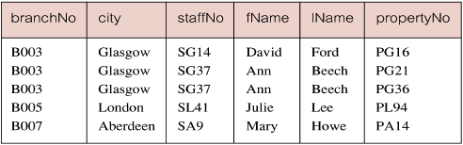
Example 6.26: Three-Table Join
For each branch, list staff who manage properties, including city in which branch is located and properties they manage. (use Branch, Staff and PropertyForRent)
SELECT b.branchNo, b.city, s.staffNo, s.fName, s.lName, p.propertyNo
FROM Branch b, Staff s, PropertyForRent p
WHERE b.branchNo = s.branchNo AND s.staffNo = p.staffNo
ORDER BY b.branchNo, s.staffNo, p.propertyNo;
21

Slide 22
Multi-Table Join with Selection Predicates
List the fname and lname of owners whose properties are managed through branches in 'London'.
SELECT DISTINCT fName, lName
FROM PrivateOwner o, PropertyForRent p, Branch b
WHERE o.ownerNo = p.ownerNo AND p.branchNo = b.branchNo AND b.city = 'London’;
22
Notes:
-- List the fname and lname of clients who have viewed a property in 'Glassgow'.
SELECT DISTINCT fname, lname
FROM client, viewing, propertyforrent
WHERE client.clientno = viewing.clientno AND
viewing.propertyno = propertyforrent.propertyno AND
propertyforrent.city = 'Glassgow'
-- List the fname and lname of owners whose properties are managed through branches in 'London'.
SELECT DISTINCT fname, lname
FROM privateowner, propertyforrent, branch
WHERE privateowner.ownerno = propertyforrent.ownerno AND
propertyforrent.branchno = branch.branchno AND
branch.city = 'London'
-- List the fname and lname of clients who are registered in branches in 'London'. (optional)
SELECT DISTINCT fname, lname
FROM client, registration, branch
WHERE client.clientno = registration.clientno AND
registration.branchno = branch.branchno AND
branch.city = 'London'
-- List the first name of the staff member who manages a property and the first name of the owner.
SELECT DISTINCT staff.fname AS staff_fname, privateowner.fname AS owner_fname
FROM staff, propertyforrent, privateowner
WHERE staff.staffno = propertyforrent.staffno AND
propertyforrent.ownerno = privateowner.ownerno

Slide 23
Multi-Table Join with Selection Predicates
List the first name of the staff member who manages a property and the first name of the property owner.
SELECT DISTINCT s.fName AS staff_fName, o.fName AS owner_fName
FROM Staff s, PropertyForRent p, PrivateOwner o
WHERE s.staffNo = p.staffNo AND p.ownerNo = o.ownerNo;
* Note that the tuple with NULL staffNo is excluded.
23
Notes:
-- List the fname and lname of clients who have viewed a property in 'Glassgow'.
SELECT DISTINCT fname, lname
FROM client, viewing, propertyforrent
WHERE client.clientno = viewing.clientno AND
viewing.propertyno = propertyforrent.propertyno AND
propertyforrent.city = 'Glassgow'
-- List the fname and lname of owners whose properties are managed through branches in 'London'.
SELECT DISTINCT fname, lname
FROM privateowner, propertyforrent, branch
WHERE privateowner.ownerno = propertyforrent.ownerno AND
propertyforrent.branchno = branch.branchno AND
branch.city = 'London'
-- List the fname and lname of clients who are registered in branches in 'London'. (optional)
SELECT DISTINCT fname, lname
FROM client, registration, branch
WHERE client.clientno = registration.clientno AND
registration.branchno = branch.branchno AND
branch.city = 'London'
-- List the first name of the staff member who manages a property and the first name of the owner.
SELECT DISTINCT staff.fname AS staff_fname, privateowner.fname AS owner_fname
FROM staff, propertyforrent, privateowner
WHERE staff.staffno = propertyforrent.staffno AND
propertyforrent.ownerno = privateowner.ownerno

Slide 24
Union, Intersect and Difference
Combine results of two or more queries into a single result table - SIMPLE
Union of two tables, A and B, is table containing all rows in either A or B or both.
Intersection is table containing all rows common to both A and B.
Difference is table containing all rows in A but not in B.
Two tables must be union compatible, means:
Two tables must contain same number of columns
Corresponding columns have the same data type & length
24
Notes:
Union compatible !! Attribute names are not important

Slide 25
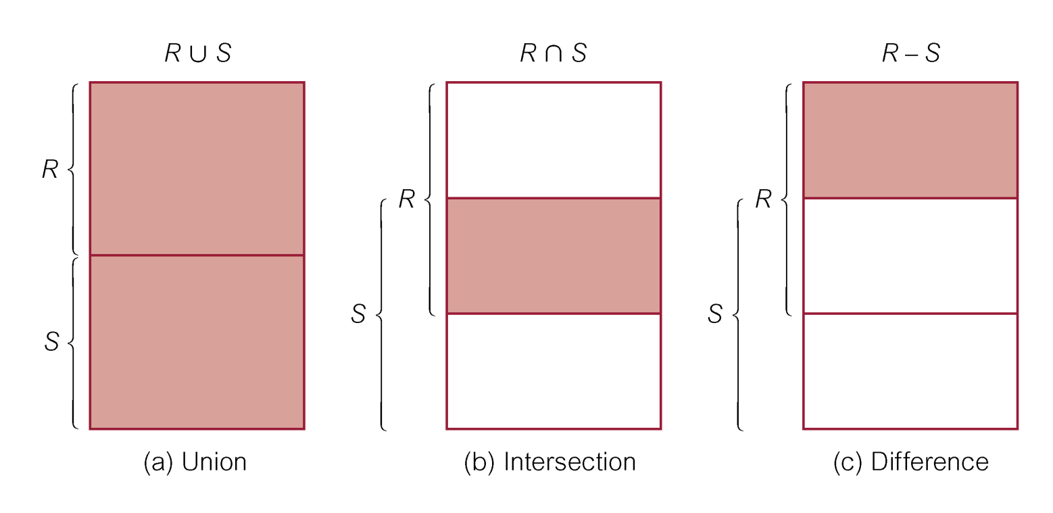
Union, Intersect and Difference
Managers who are Female or Below 40
Managers who are Female and Below 40
Managers who are Female, but not below 40

Slide 26
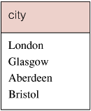
Example 6.32: Use of UNION
List all cities where there is either a branch or property.
( SELECT city FROM Branch
WHERE city IS NOT NULL )
UNION
( SELECT city FROM PropertyForRent
WHERE city IS NOT NULL );
Or…
( SELECT city FROM Branch WHERE city IS NOT NULL )
UNION CORRESPONDING BY city
( SELECT city FROM PropertyForRent WHERE city IS NOT NULL )
26

Slide 27
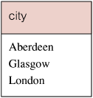
Example 6.33: Use of INTERSECT
List all cities where there is both a branch and rental property.
( SELECT city FROM Branch )
INTERSECT
( SELECT city FROM PropertyForRent );
Or…
( SELECT city FROM Branch )
INTERSECT CORRESPONDING BY city
( SELECT city FROM PropertyForRent );
27

Slide 28
Example 6.34: Use of EXCEPT
Which cities have a branch but do not have a property for rent?
( SELECT city FROM Branch )
EXCEPT
( SELECT city FROM PropertyForRent );
28

Slide 29
In Class Practice – Use Intersect, Union, Except Question 14-16 (4min)
List propertyNO for all houses, AND all flats with >=4 room
List propertyNO for properties that has not been viewed
List staffNo for all staffs whose salary is above 11000 and who manages at least one property

Slide 30
In Class Practice – Use Intersect, Union, Except Question 14-16
List propertyNO for all houses, AND all flats with >=4 room
List propertyNO for properties that has not been viewed
List staffNo for all staffs whose salary is above 11000 and who manages at least one property
(SELECT propertyNO FROM PropertyForRent WHERE type=‘House’)
UNION
(SELECT propertyNO FROM PropertyForRent WHERE type=‘Flat’ AND room>=4)
(SELECT propertyNO FROM PropertyForRent)
EXCEPT
(SELECT propertyNO FROM Viewing)
(SELECT staffNO FROM Staff WHERE salary>11000)
INTERSECT
(SELECT staffNo FROM PropertyForRent)

Slide 31
Example 6.33: Use of INTERSECT -- Alternatives (optional slide)
Could rewrite this query without INTERSECT:
SELECT DISTINCT b.city
FROM Branch b, PropertyForRent p
WHERE b.city = p.city;
Or…
SELECT DISTINCT city FROM Branch b
WHERE EXISTS (
SELECT * FROM PropertyForRent p
WHERE p.city = b.city );
31

Slide 32
Example 6.34: Use of EXCEPT – Alternatives (optional slide)
Could rewrite this query without EXCEPT:
SELECT DISTINCT city FROM Branch
WHERE city NOT IN (
SELECT city FROM PropertyForRent );
Or…
SELECT DISTINCT city FROM Branch b
WHERE NOT EXISTS (
SELECT * FROM PropertyForRent p
WHERE p.city = b.city );
32

